Slide 1
Introduction to SAP & S/4HANA R2R

Slide 2
After completing this lesson, participants will be able to -
Know the meaning of ERP
Introduction to SAP
SAP Landscape
Understand the S/4 Hana system
Understand the Basics of SAP
Overview of S/4 Hana R2R Module
Sub-Modules of SAP R2R
Lesson Objectives

Slide 3
Introduction to ERP
What is ERP?
E – Enterprise R – Resource P – Planning
Definition:
An integrated information system that serves all departments within an enterprise
ERP is a way to integrate the data and processes of an Organization into one single system
Software solution that addresses the enterprise needs taking the process
View of an organizational goals tightly integrating all functions of an enterprise

Slide 4
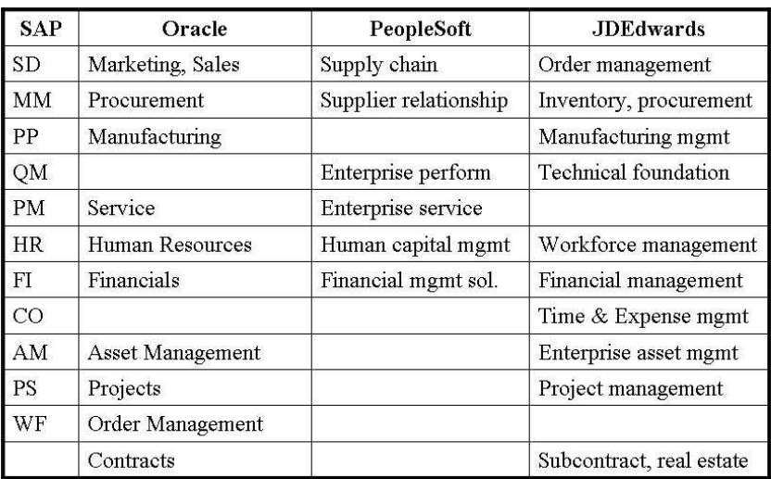
Introduction to ERP

Slide 5

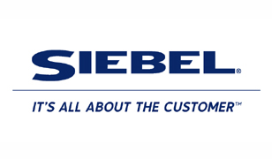




ERP Vendors

Slide 6
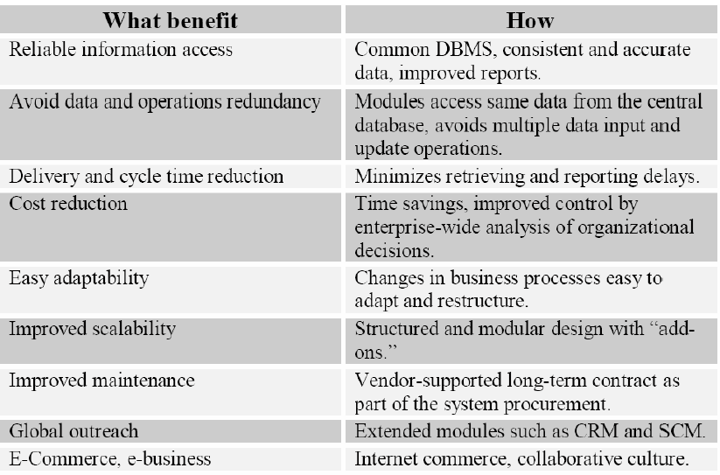
Introduction to ERP

Slide 7
ERP Overview
Is a high-end sophisticated software solution that reduces the pressure and workload of the managers
Provides accurate, timely information for taking appropriate business decisions.
Managers with knowledge of ERP will be able to achieve their targets and goals by proper implementation of ERP system in their organization
In fact managers are expected to translate the business rules and requirements for mapping them into ERP software
Implementation of ERP solutions is one of the largest drivers of growth in the consultancy business
ERP automates the tasks involved in performing a business process

Slide 8
ERP Extension
Web Enable
Customer Relationship Management (CRM)
Supply Chain Management (SCM)
Strategic Enterprise Management (SEM)
Business Information Warehouse (BIW)
Knowledge Management (KM)
So on …

Slide 9
ERP Functional Systems
Typically contained within a department
Islands of automation
Applications independently developed and deployed
Driving force: Availability of mini-computers
Human resources System:
Recruiting
Compensation
Assessment
Development and Training
Planning
Applications:
Human resources System
Accounting and finance systems
Sales and marketing System
Operations management System
Manufacturing Systems
Accounting and finance systems:
General Ledger
Financial Reporting
Costing
Budgeting
Accounts Payable
Accounts receivables

Slide 10
ERP Functional Systems
Sales and marketing System:
Lead tracking
Sales forecasting
Customer management
Operations management System:
Order management
Inventory management
Customer service
Manufacturing Systems:
Inventory
Planning

Slide 11
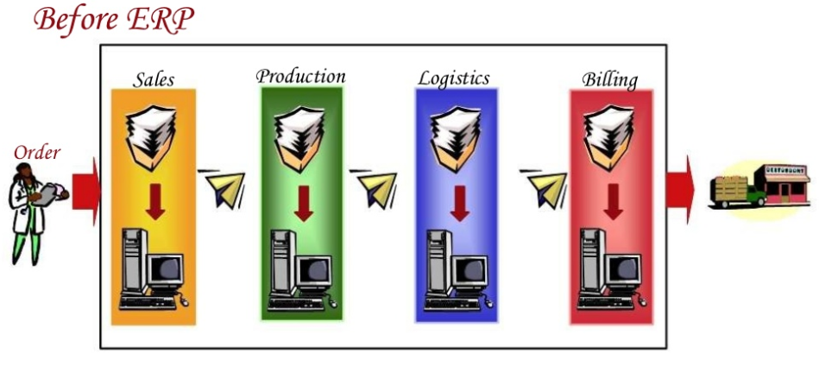
ERP Functional Systems
Problems: Delays, Lost orders, Keying into different computer systems invites errors

Slide 12
Problems with function based application
Sharing of data between systems
Data duplication
Data inconsistency
Applications that don’t talk to one another
Limited or lack of integrated information
Isolated decisions lead to overall inefficiencies
Increased expenses

Slide 13
Order fulfillment with ERP
Helps integrate management, staff, and equipment, combining all aspects of the business into one system
Facilitates every element of the manufacturing process
Groups traditional company and management functions (such as accounting, human resources [HR], manufacturing management, and customer relationship management [CRM]) into a coherent whole
Manufacturing management also includes inventory, purchasing, and quality and sales management
Today’s leading ERP systems group all traditional company management functions (finance, sales, manufacturing, and human resources)
Many systems include with varying degrees of acceptance and skill, solutions that were formerly considered peripheral product data management (PDM), warehouse management, manufacturing execution system (MES), and reporting
During the last few years the functional perimeter of ERP systems began an expansion into its adjacent markets
For example, supply chain management (SCM), customer relationship management (CRM), business intelligence/data warehousing, and e-business
The focus of this knowledge base is mainly on the traditional ERP realms of finance, materials planning, and human resources
The foundation of any ERP implementation must be a proper exercise of aligning customers'' IT technology with their business strategies, and subsequent software selection

Slide 14
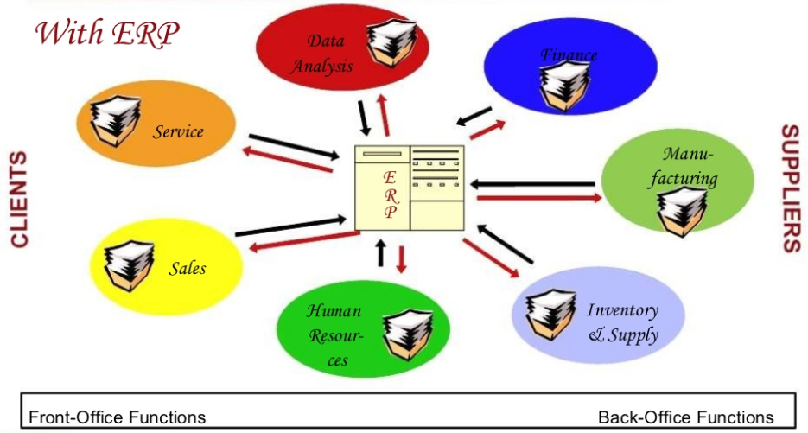
An Example: Order Fulfillment

Slide 15
Introduction to SAP
About SAP:
In 1972, five former IBM employees -- Dietmar Hopp, Hans-Werner Hector, Hasso Plattner, Klaus Tschira, and Claus Wellenreuther -- launch a company called Systems, Applications, and Products in Data Processing in Mannheim, Germany. Their vision: to develop standard application software for real-time business processing
The original name for SAP was German: Systeme, Anwendungen, Produkte, and German for "Systems Applications and Products." The original SAP idea was to provide customers with the ability to interact with a common corporate database for a comprehensive range of applications. Gradually, the applications have been assembled and today many corporations, including IBM and Microsoft, are using SAP products to run their own businesses
SAP developed and released several versions of R/3 through 1995. By the mid-1990s, SAP followed the trend from mainframe computing to client/server architectures
In 2015, the company launched the newest generation of the SAP Business Suite. It was written natively for the SAP HANA platform
The most recent SAP Enhancement Package for SAP ERP 6.0 was EhP8, which was released in 2016. EhP8 delivers innovations and serves as a foundation to transition to SAP’s new business suite: SAP S/4HANA

Slide 16
Introduction to SAP
The 1980s: Rapid Growth
SAP moves into the company's first building on Max-Planck-Strasse in an industrial park in Walldorf, near Heidelberg. Our software development area and its 50 terminals are all now under one roof. Fifty of the 100 largest German industrial firms are already SAP customers
The SAP R/2 system attains the high level of stability of the previous generation of programs. Keeping in mind its multinational customers, SAP designs SAP R/2 to handle different languages and currencies. With this and other innovations in SAP R/2, SAP sees rapid growth
By the middle of the decade, SAP founds its first sales organization outside Germany, in Austria. The company makes its first appearance at the CeBIT computer fair in Hanover, Germany. Revenues reach DM 100 million (around $52 million), earlier than expected
In August 1988, SAP GmbH becomes SAP AG. Starting on November 4, 1.2 million shares are listed on the Frankfurt and Stuttgart stock exchanges
Germany's renowned business journal, manager magazine, names SAP its Company of the Year -- a distinction we would receive twice more in the next few years
With the founding of subsidiaries in Denmark, Sweden, Italy, and the United States, SAP's international expansion takes a leap forward

Slide 17
Introduction to SAP
The 2000s: Innovation for the New Millennium
With the Internet, the user becomes the focus of software applications. SAP develops SAP Workplace and paves the way for the idea of an enterprise portal and role-specific access to information.
Currently, more than 12 million users work each day with SAP solutions. There are now 121,000 installations worldwide, more than 1,500 SAP partners, over 25 industry-specific business solutions, and more than 41,200 customers in 120 countries. SAP is the world's third-largest independent software vendor.
SAP are categorized into 3 core functional areas:
Logistics :
Sales and Distribution (SD)
Material Management (MM)
Warehouse Management (WM)
Production Planning (PP)
General Logistics (LO)
Quality Management (QM)

Slide 18
Introduction to SAP
In 2015, the company launched the newest generation of the SAP Business Suite. It was written natively for the SAP HANA platform. It offers cloud, on-premises and hybrid deployment options to customers, with its benefits including a smaller data footprint, higher throughput, faster analytics and faster access to data. It also allows existing SAP Business Suite customers to upgrade to this product from SAP Business Suite
In 2016, SAP introduced SAP HANA, Express Edition which is meant to run on personal computers or on cloud computing platforms for students and other small-scale developers
On January 29, 2019, SAP announced plans to cut approximately 4,000 positions at the company in a strategic plan to shift to more modern cloud-based technologies such as blockchain, quantum computing, machine learning, Internet of Things, and artificial intelligence

Slide 19
SAP Landscape

Slide 20
Why S/4 HANA
S/4 HANA is SAP’s latest version of its Enterprise Resource Planning (ERP) system, running on its advanced in-memory database HANA and providing the most modern user experience, SAP Fiori. The standard set of applications delivered with each S/4 HANA system are the following:
PP (Production Planning)
MM (Materials Management)
SD (Sales and Distribution)
FI (Financial Accounting New)
CO (Controlling)
AM (Fixed Assets Management)
PS (Project System)
WF (Workflow)
IS (Industry Solutions)
Product Life Cycle Management (PLM)
Human Capital Management (HCM)
PM (Plant Maintenance)
QM (Quality Management)
Investment Management (IM)
Strategic Enterprise Management (SEM)
Customer Relationship Management (CRM)
Logistics Information Systems (LIS)
Supply Chain Management (SCM)
Treasury
NetWeaver
Notes:
The above applications are called the functional areas, or application areas, or at times the functional modules of R/3. All of these terms are synonymous with each other.

Slide 21
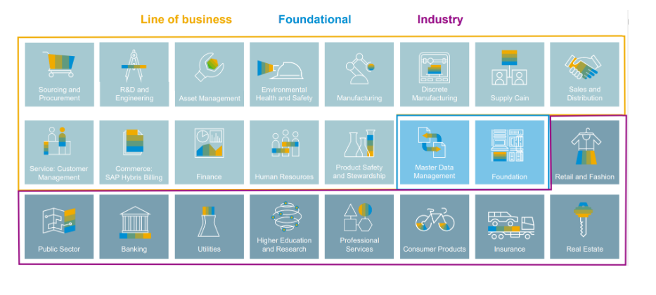
SAP Core Modules

Slide 22
Defining S/4 HANA
SAP S/4HANA is the short form for SAP Business Suite 4 SAP HANA
It brings the next big wave of SAP innovation to our customers, similar to the transition from SAP R/2 to SAP R/3
It is a new product fully built on the most advanced in-memory platform today – SAP HANA – and modern design principles with the SAP Fiori user experience (UX)R/3

Slide 23
SAP R/3 Architecture

Slide 24
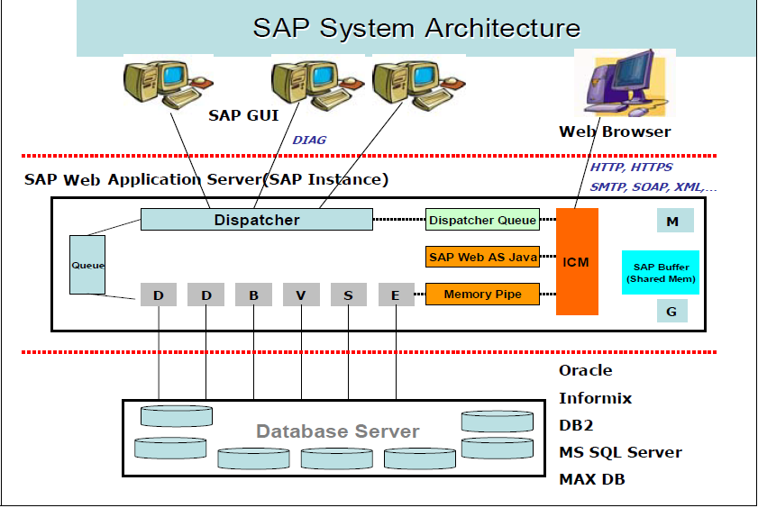
Application Server Architecture
The components of an application server are shown in the figure below. It consists of a dispatcher and multiple work processes

Slide 25
Application Server Architecture
All requests that come in from presentation servers are directed first to dispatcher
The dispatcher writes them first to the dispatcher queue
The dispatcher pulls the requests from the queue on a first-in, first-out basis
Each request is then allocated to the first available work process
A work process handles one request at a time
To perform any processing for a user’s request, a work process needs to address two special memory areas: the user context and the program roll area
The user context is a memory area that contains information about the user, and the roll area is a memory area that contains information about the programs execution

Slide 26
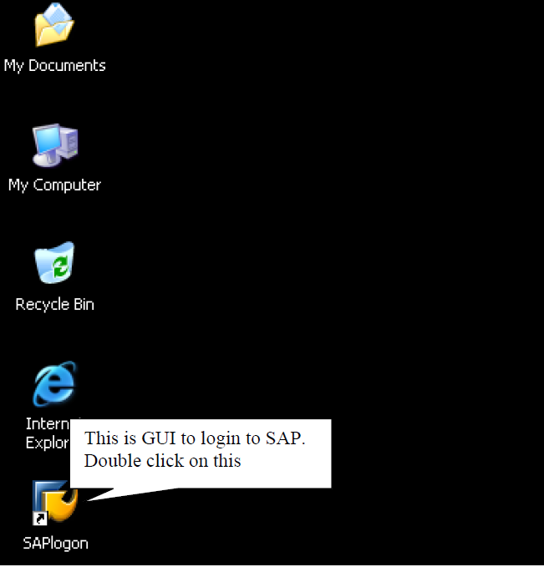
LOGIN IN TO SAP
On the Screen of your desktop. This Icon is GUI(Graphical User Interface) which helps you to login to or to enter into the SAP. When You double Click on this it will display the following Screen.

Slide 27
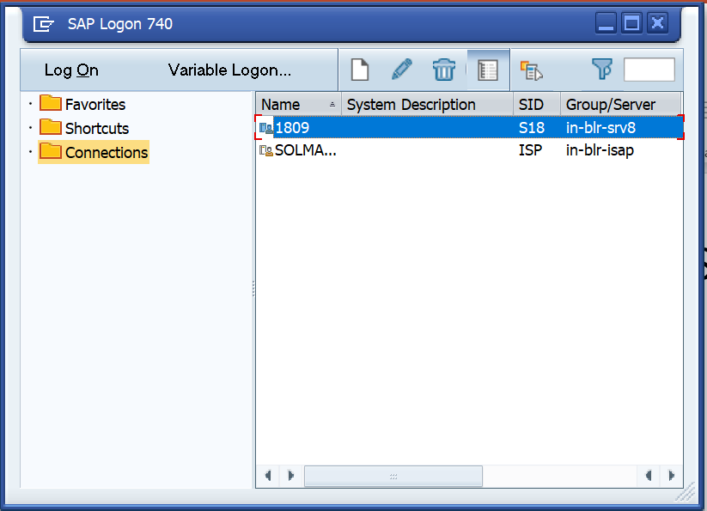
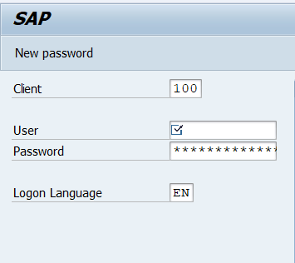
LOGIN IN TO SAP
Now, Select the system as displayed on screen and click on “Log On” button which will take you to the login screen on SAP as below.
Enter the Provided User name and password, Press Enter key and you will be now into SAP Screen

Slide 28
SAP FI Overview
Purpose
Use
Challenges

Slide 29
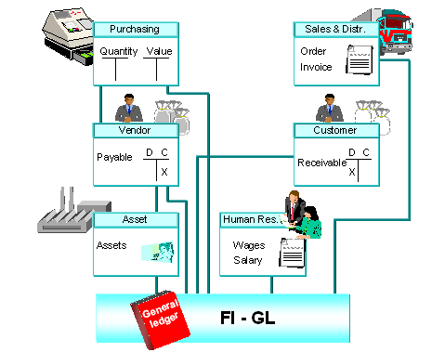
Purpose
Financial Accounting (FI) is the key building block to an organization on which most other modules depend on
FI Organization Elements ensure that other modules work in sync with business requirements
FI Organization Elements enable a thorough analysis of current business operations and enable planning scenarios
FI Organization Elements are assigned to Organization Elements from other modules viz. Sales Organization in SD, Purchasing Organization in MM, Plant in Logistics, this ensures the real time integration of FI with all other modules
The central task of G/L accounting is to provide a comprehensive picture for external accounting and accounts
Recording all business transactions (primary postings as well as settlements from internal accounting) in a software system that is fully integrated with all the other operational areas of a company ensures that the accounting data is always complete and accurate

Slide 30
Use
FI Organization Elements involve defining and configuring the elements which will enable an organization to:
Purchase materials from vendors (Payables Accounting)
Make sales to customers (Receivables Accounting)
Internal and External reporting of financials to stakeholders (Balance Sheet, Profit & Loss Account, Cash Flow etc.)
Accounting & Control of Fixed Assets -Capitalize and depreciate (Asset management)
Make and receive payments (Treasury Management)
Enable planning for future projects (Investment management)
Profitability & other MIS Analysis for various products, segments, cost objects (Controlling)

Slide 31
Challenges
It is the most critical decision to define the FI Organization Structure and its elements based on business process since all other modules or business functions are linked to FI and information is gathered and consolidated in FI for various reporting purposes.

Slide 32
Sub Modules in FI/CO
FINANCIAL ACCOUNTING
FI-GL General Ledger Accounting
FI-AR Accounts Receivable
FI-AP Accounts Payable
FI-LC Legal Consolidation
FI-SL Special Purpose Ledger
FI-AA Asset Accounting
TR – Treasury
TR-CM Cash Management
TR-FM Funds Management
TR-TM Treasury Management
CONTROLLING
CO-OM Overhead Cost Controlling
CO-PC Product Cost Controlling
CO-PA Sales & Profitability Analysis
CO-ABC Activity Based Costing
EC - Enterprise Controlling
EC-PCA Profit Center Accounting
EC-EIS Executive Information System
IM - Investment Management
FM-Funds Management
IM- FA – Tangible Fixed Assets

